Slide 1
Topic 7: Multi-Sided platforms
Antitrust Economics 2013
David S. Evans
University of Chicago, Global Economics Group
Elisa Mariscal
CIDE, ITAM, CPI
Topic 7 | Part 2 23 May 2013
Date

Slide 2
Overview
Part 1
Overview
Interdependent Demand
Part 2
Competitive Bottlenecks and Multihoming
Pricing and Welfare
Profit-Maximization
Critical Mass and Ignition
Platform Competition
Maximizing value
Notes:
PLEASE CHANGE COLORS SO RIGHT HAND SIDE IS SHADED IN. CHANGE SLIDE IN THE LECTURE AS WELL TO ADD THE PLATFORM COMPETITION COMPONENT. GO BACK AND CHANGE DECK FOR 7.1 TO ADD PLATFORM COMPETITION IN

Slide 3
Maximizing Value

Slide 4
Platform Maximizes Value
By internalizing network effects through:
Pricing: Relative prices to two sides and access charges and variable fees.
Design Decisions: Facilitating interactions and Getting customers on board platform.
Rules and Regulations: Regulating interactions and Prevent negative externalities

Slide 5
How platforms internalize network effects
By internalizing network effects through:
Pricing: Magazines price low to readers to get their “eyeballs” which they then sell to advertisers.
Design Decisions: Shopping malls design space to encourage foot traffic to stores while making walking around mall enjoyable for shopper.
Rules and Regulations: Auctions penalize sellers for defective merchandise and buyers for nonpayment.

Slide 6
Platforms harness externalities
A Place to Get Together
Ways to Connect and Create Value
Manage externalities
Platforms manage positive and negative externalities to increase value that members can realize from the platform.
Platform provides search and matching methods for helping customers find “value-creating” transactions and for exchanging value.
Platform provides a physical or virtual environment for different types of customers to get together.

Slide 7
Platform design and rules promote positive externalities
“Exclusionary vibe”
(JDate discourages Gentiles)
“Exclusionary amenity”
(Upscale anchor stores discourages low-end shoppers)
Search Diversion
Design rules encourage one type of agent to meet another type of agent who really values them but may not seek out by themselves
Shopping malls with anchor stores at either end
Sorting Devices to Get Right Customers

Slide 8
Governance mitigates negative externalities
Rules
Prohibitions on actions that could harm other agents
(usually those on other side of match/transaction)
eBay has detailed rules for buyer and seller behavior
No misleading ads (sellers) and no multiple auctions for same good (buyers)
Detection and Monitoring
Systems to determine if rules are being broken
Facebook has hundreds of employees looking for bad pictures and bad language
Enforcement
Platforms have and use “Bouncers Rights” to exclude violators
Google manually reduces ranks of websites that violate rules for 90 days and sometimes delists websites
Notes:
Google has sent BMW, JC Penney and many other companies to the penalty box—basically deep down in the search rankings—for using prohibited tactics for artificially increasing their traffic/rankings.

Slide 9
Welfare effects of rules
Promoting positive externalities has costs
Sorting devices harm customers that can’t get on platform or don’t get their preferred matches
Search diversion benefits side that gets from looks but not necessarily side that has been diverted.
Governing bad behavior has costs
Customers lose benefits from violations
Customers also lose from false positives in enforcement
Platform has incentives to balance benefits and costs
Platform can make more money by promoting positive externalities and reducing negative ones
Platform value is greater and platform profit greater too
Notes:
Google has sent BMW, JC Penney and many other companies to the penalty box—basically deep down in the search rankings—for using prohibited tactics for artificially increasing their traffic/rankings.

Slide 10
Multihoming

Slide 11
Multi-homing key concept for platforms
Customers may use one or more platforms to interact with customers on other side.
Customers “single-home” when they use only one platform and therefore restrict themselves to interacting with the customers on the other side of that platform. Most people use one operating system.
Customers “multi-home” when they use two or more platforms and therefore can access customers on any of the platforms they use. Many people to to multiple shopping malls.
Multi-homing is a feature in describing structure and analyzing pricing and competition.
Notes:
We saw zero and really less than zero with OpenTable. Now this is BIG. Its HUGE. Platforms choose pricing levels. But they also choose a pricing structure that determines the relative prices for the two sides.

Slide 12
Tentative examples of multi-homing
Payment Cards:
People use several and merchants accept many
Advertising Supported Media:
Advertisers rely on several and people read several
Software Platforms:
People use one per device and developers write for several

Slide 13
‘Homing more complicated than it seems
Single and multi-homing can refer to whether customers have access to, e.g. are members of, one or more platforms. Men and women can go to one or many dating environments.
Single and multi-homing can also refer to whether customers on one side dictate the choice of a particular platform for a particular interaction. On a particular evening a man and a woman are only at one particular platform.
It a customer has a high cost of switching from platform at the time of that interaction or places a high value on using that platform at that time of interaction then customers on the other side cannot interact with that customer unless they use the same platform
Notes:
We saw zero and really less than zero with OpenTable. Now this is BIG. Its HUGE. Platforms choose pricing levels. But they also choose a pricing structure that determines the relative prices for the two sides.

Slide 14
Competition for single homing customers
When customers single home there can be intense competition for those customers because the platform that has those customers has a “monopoly” on accessing those customers.
This intense competition can lead to low (less than marginal cost, zero or possibly less than zero) prices for the single-homing customers who then become the “subsidy” side of the platform.
The platform then makes profits from the multi-homing side of the platform.
Notes:
We saw zero and really less than zero with OpenTable. Now this is BIG. Its HUGE. Platforms choose pricing levels. But they also choose a pricing structure that determines the relative prices for the two sides.

Slide 15
Switching costs and multi-homing Strategies
Exclusives: Shopping mall prevents store from operating within 25 mile radius
Design: Issue in Microsoft case involved limitations on using competing features for those included in Windows
Loyalty: American Express gives rewards to encourage usage and get “top of wallet”

Slide 16
Single homing and pricing in practice
Consumers are often looking at only one media at a time therefore intense competition for access to those eyeballs at that time.
Payment card customers may have high cost of switching payment instruments at point of interaction and therefore intense competition for cardholders.
People usually only use one operating system for their personal computers but application developers are subsidy side and users (or equipment makers who sell to users) are money side.
Notes:
We saw zero and really less than zero with OpenTable. Now this is BIG. Its HUGE. Platforms choose pricing levels. But they also choose a pricing structure that determines the relative prices for the two sides.

Slide 17
Pricing Strategies

Slide 18
Profit level versus pricing structure
Platforms must choose a pricing structure (fraction of incremental profits earned from each side) in addition to pricing levels
Pricing levels directly determine overall profitability of platform.
Pricing structure reflects platform decision on solving demand coordination problem arising from usage and membership externalities. Pricing structure indirectly determines overall profitability of platform
Notes:
We saw zero and really less than zero with OpenTable. Now this is BIG. Its HUGE. Platforms choose pricing levels. But they also choose a pricing structure that determines the relative prices for the two sides.

Slide 19
Rules of thumb for pricing structure
Need to get both sides on board. Viewers and advertisers, app developers and operating system users, stores and shoppers, etc.
Need to get right proportions. Buyers must have access to enough sellers, men to enough women, liquidity takers to enough liquidity providers, diners to enough restaurants.
Higher price
(“Money side”)
Needed less by other side
Inelastic demand
Lower price
(“Subsidy side”)
Harder to get
Needed more by other side
More elastic demand
Bottleneck asset
Easier to get
Notes:
Often talk about having a money side and a subsidy side. The characteristics are correlated. So customers that are harder to get probably have a more elastic demand.
Below-cost pricing is common. But it isn’t ubiquitous. So dating sites are relatively balanced. eHarmony men and women pay same price. Some nightclubs have free drinks for girls but compared to other platforms pricing tend to be symmetric.

Slide 20
Software platforms and pricing
PLATFORM | USERS | DEVELOPER | COMMENT
Windows | Pays | Subsidized | App developers get API access for free and cheap or free tools
Sony PlayStation | Subsidized | Pays | Users get consoles for no more than cost and game developers pay commissions
iPhone OS/Hardware | Pays | Free for free apps Paid for paid apps | Users pay for phones and developers pay commissions on sales through App Store (but not from other revenue sources)
Facebook | Free | Paid for game developers and currently free for | Facebook takes 30% of revenue game application developers and its contracts would allow it to do that for others
Notes:
PLEASE FIT THIS TO THE PAGE

Slide 21
Ignition and Critical Mass

Slide 22
YouTube ignited in late 2005
Both sides essential for launch
YouTube needed content creators and content viewers
Need strategies to get both sides on board
Ignition requires getting enough on board
Slow growth from February to December 2005 when YouTube shows an inflection point
YouTube tried multiple strategies to increase uploading and viewing of videos
Notes:
There’s a lot of documentation on what happened during that first year. One of the founders did an hour long presentation at Stanford in 2006 that went over what they did in detail. It was daily blocking and tackling to try to get people to upload videos and to watch them.
Some things worked. Some things didn’t. Like asking pretty girls to upload videos of themselves.
You can see the inflection point in the data. That’s where YouTube reached critical mass and ignited.

Slide 23
Platforms need critical mass to ignite
Critical mass
Critical mass refers to the minimal set of customers on each side that is large enough to attract more customers and result in sustainable positive feedback
Critical mass depends on scale and balance
Probability of customers from two sets getting together and exchanging value increases with the number of customers on each side
Platforms implode if they can’t reach critical mass
If there aren’t enough customers on the other side the probability of advantageous exchange falls and customers don’t join and the early adopters who have eventually leave
Notes:
Every platform needs to get critical mass to reach an ignition point.
Think about operating an exchange with buyers and sellers—bazaar, market in credit default swaps, B2B exchange etc.
Back around 2000 hundreds of B2B exchanges started. Buyers but not enough sellers.

Slide 24
Successful launch requires critical mass
Critical mass corresponds to a combination of scale and balance that is minimally sufficient to ignite the platform
Notes:
There usually isn’t a unique point. There are many. Here’s an example.

Slide 25
Critical mass, platform ignition and growth
In this example the critical mass points are between C’ and C”.
C* is the point that would lead to optimal platform launch.
Points to the NW of the vector 0-C’ and to the SW of vector 0-C” would result result in platform implosion.
Side A
Notes:
There is in fact often a frontier of points. If you can reach that frontier you can ignite. If you don’t reach that frontier the platform will implode. Platform startup is about reaching that frontier.

Slide 26
Three phases of platform growth
Initiation
Platform undertakes strategies to get to critical mass
Ignition and Rapid Growth
Maturity
Platform reaches profitable equilibrium and grows through competition and market growth
Platform reaches critical mass and gets self-sustaining positive feedback effects
Some platforms can secure precommitments from both sides and
thereby collapse initiation and ignition into immediate growth at
startup.
Notes:
There’s a lot of documentation on what happened during that first year. One of the founders did an hour long presentation at Stanford in 2006 that went over what they did in detail. It was daily blocking and tackling to try to get people to upload videos and to watch them.
Some things worked. Some things didn’t. Like asking pretty girls to upload videos of themselves.
You can see the inflection point in the data. That’s where YouTube reached critical mass and ignited.

Slide 27
Initiation and getting to critical mass
Early adopters
Customers who like to try new things
High-value customers
Customers that place high expected value on participating in the platform
Highly attractive customers
Customers on one side who are highly valued to customers on the other sides
Exclusive deals
Exclusive deals force customers on the other side to use the platform to gain access to these customers
Expected success
Shape customer expectations that the platform will provide value in order to get customers to multi-home or single home on platform

Slide 28
Platform Competition

Slide 29
Most platform compete with other platforms
Long-lived platform monopolies are rare
Many successful platforms face direct competition
Positive feedback effects don’t insure a single winner
They limit the number of successful firms but multiple platforms survive by appealing to different types of customers on both sides
Positive feedback effects work in reverse
They drive rapid growth but competition can lead to a death spiral when they work in reverse

Slide 30
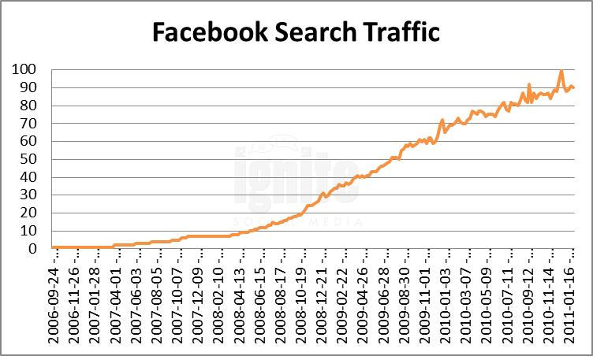
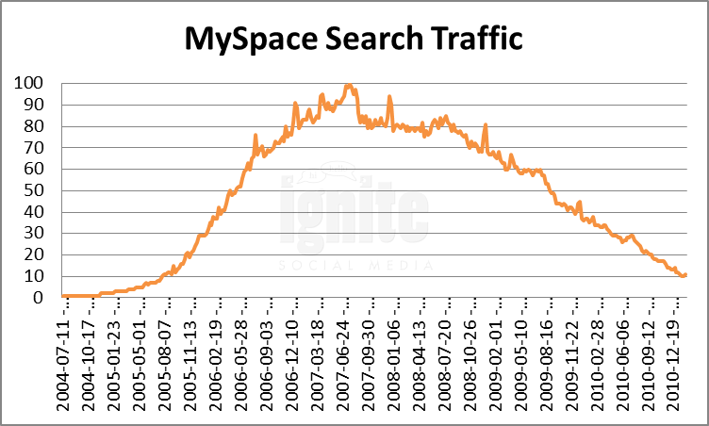
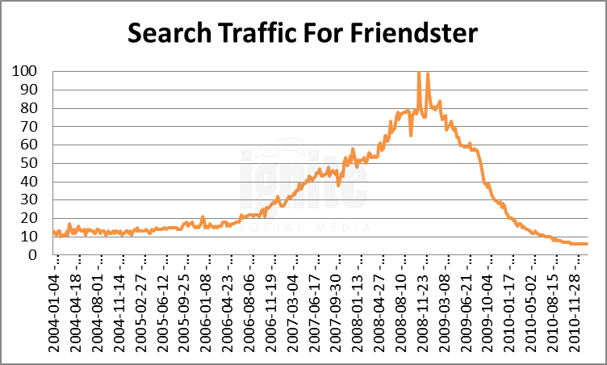
The MySpace “Monopoly”
Facebook
MySpace
Friendster
2011 Social Network Analysis Report, http://www.ignitesocialmedia.com
“MySpace is far and away the de facto standard for social networking and is highly entrenched in the youth culture of today.”
“We see MySpace as the new MTV, with one crucial difference: the users are the stars.”
IMEDIACONNECTION, 2006
MASHABLE, 2006
The long-lived Windows dominance on PCs is (was?) the exception to the rule that platform markets usually aren’t winner take all.

Slide 31
Determinations of competition
Cause | Effect on Size/Concentration
Indirect network effects | +
Scale economies | +
Congestion | –
Platform differentiation | –
Multi-homing | –
In practice most multi-sided industries have several competing differentiated MSPs, Scale and indirect network effects don’t result in market tipping to monopoly usually.

Slide 32
Determinants of industry structure
Cause | Effect on Size/Concentration
Indirect network effects | +
Scale economies | +
Congestion | -
Multi-homing (customers use several platforms) | -
Platform differentiation | -
In practice most multi-sided industries have several competing differentiated MSPs, Scale and indirect network effects don’t result in market tipping to monopoly usually.

Slide 33
Symmetric vs. asymmetric competition
Symmetric Competition
Competitors have same number of sides and types of users
Asymmetric Competition
Competitors have similar pricing structures including decisions on money vs. subsidy side
Rival has extra side(s); both have same side but one has a different one
Rival has one side in common but one side different
Rival has radically different pricing structure

Slide 34
Examples of asymmetric competition
Enveloping Platform
Rival has extra side
Microsoft has 2-sided user/developer software platform
Intersecting Platforms
Rival has different side
Tencent provides IM for users, sells advertising
Different Pricing
Google provides free software to users, Microsoft doesn’t
Google had 2-sided search/advertising platform plus 2-sided user/developer software platform
Google could provide free software, Microsoft couldn’t because that was rev source.
Qihoo provides anti-virus software for users, sells advertising
They compete for users by providing different products to attract users but both looking to sell advertising
nytimes.com charges viewers, cnn.com doesn’t
Developers don’t pay to develop PC games, but do to develop console games

Slide 35
Overview
Part 1
Overview
Interdependent Demand
Part 2
Competitive Bottlenecks and Multihoming
Pricing and Welfare
Profit-Maximization
Critical Mass and Ignition

